Slide 1

Project Title - Seasonal Agriculture Performance Analysis
VOIS AICTE Batch 1 2026–2027
Aditya Bhagour GLA University, Mathura
AICTE STU ID : STU6a5e59efebd351784568303

Slide 2

PROBLEM STATEMENT
Agricultural performance varies with season, environmental conditions, farming practices, resource usage and market conditions. Raw farm-level data does not clearly reveal how yield, profitability and resource efficiency change across Kharif, Rabi and Zaid seasons. This project analyzes 4,000 farm records across 8 states and 8 crops to identify seasonal patterns, relationships, significant differences and actionable insights for evidence-based agricultural planning.

Slide 3
Project Description
The project performs a complete data analytics workflow on 4,000 farm records covering 8 Indian states, 8 crops and 3 seasons: Kharif, Rabi and Zaid. The notebook includes dataset understanding, data cleaning, missing-value handling, duplicate checks, outlier investigation using the IQR method, descriptive statistics, univariate/bivariate/multivariate analysis, correlation analysis and seasonal comparisons. A one-way ANOVA is used to test whether seasonal differences in yield and profit are statistically significant. The analysis then converts the findings into practical recommendations focused on yield, profitability, water efficiency and seasonal resource planning.

Slide 4

WHO ARE THE END USERS?
Farmers & farm managers — improve seasonal crop and resource decisions.
Agricultural planners — compare seasonal performance and identify risk areas.
Agribusinesses — understand profitability and resource-efficiency patterns.
Agricultural researchers — investigate crop, state and environmental relationships.
Data analysts / students — use the workflow as a reproducible agriculture analytics case study.

Slide 5

Technology Used
Python Core programming & analysis
Pandas Data cleaning, grouping & aggregation
NumPy Numerical computation
Matplotlib Data visualization
Seaborn Statistical plots
SciPy ANOVA & statistical testing
Google Colab Notebook execution
GitHub Dataset & notebook version control

Slide 6
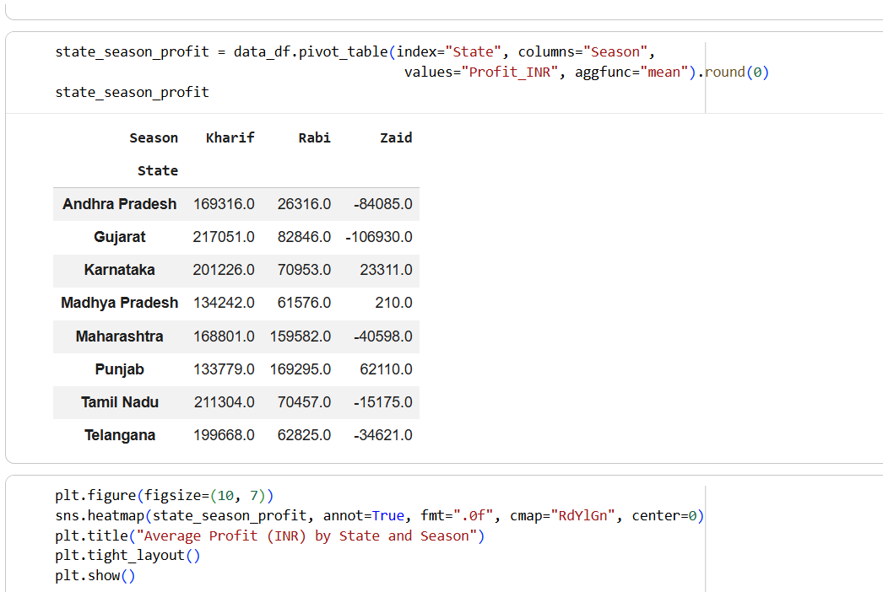
RESULTS
Average Profit by State and Season
Notebook result
State-level profitability varies strongly by season, with Zaid showing losses in most states.

Slide 7
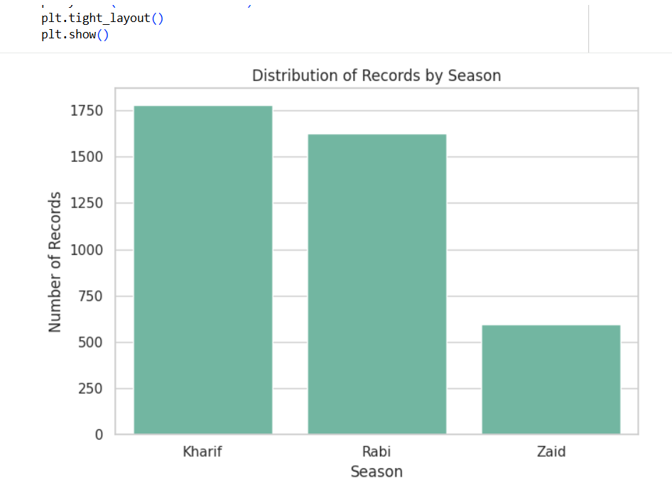
RESULTS
Distribution of Records by Season
Notebook result
Kharif has the highest number of records, followed by Rabi and Zaid.

Slide 8
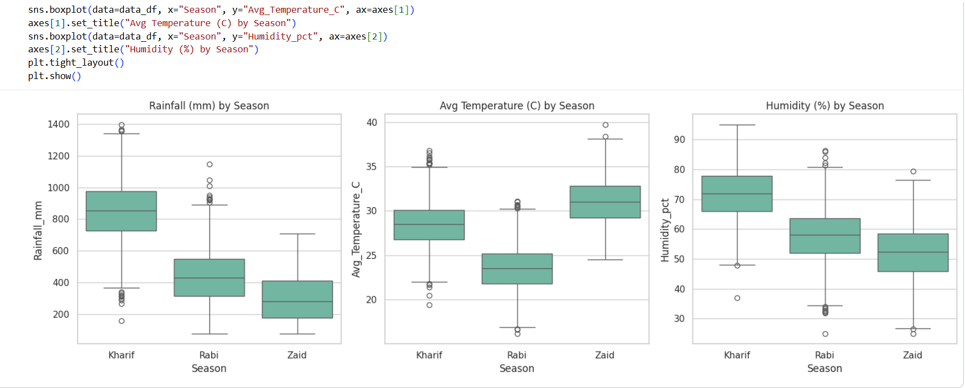
RESULTS
Rainfall, Temperature & Humidity by Season
Notebook result
Environmental conditions show clear seasonal patterns in rainfall, temperature and humidity.

Slide 9
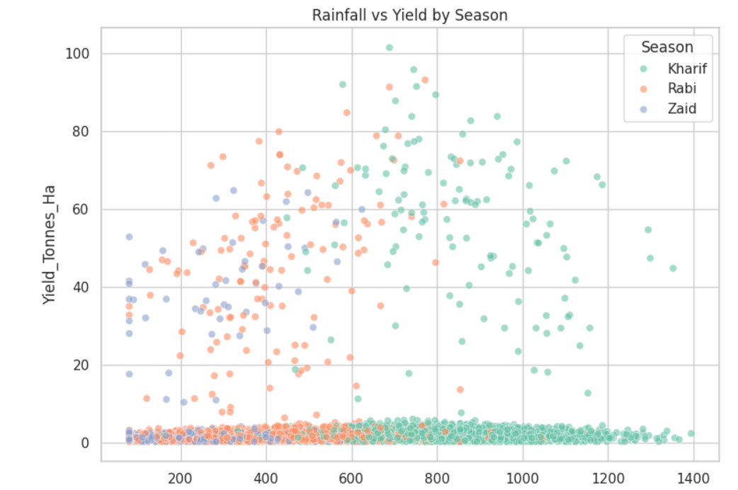
RESULTS
Rainfall vs Yield by Season
Notebook result
Rainfall alone has a very weak relationship with yield (r = 0.029), indicating that other factors matter more.

Slide 10
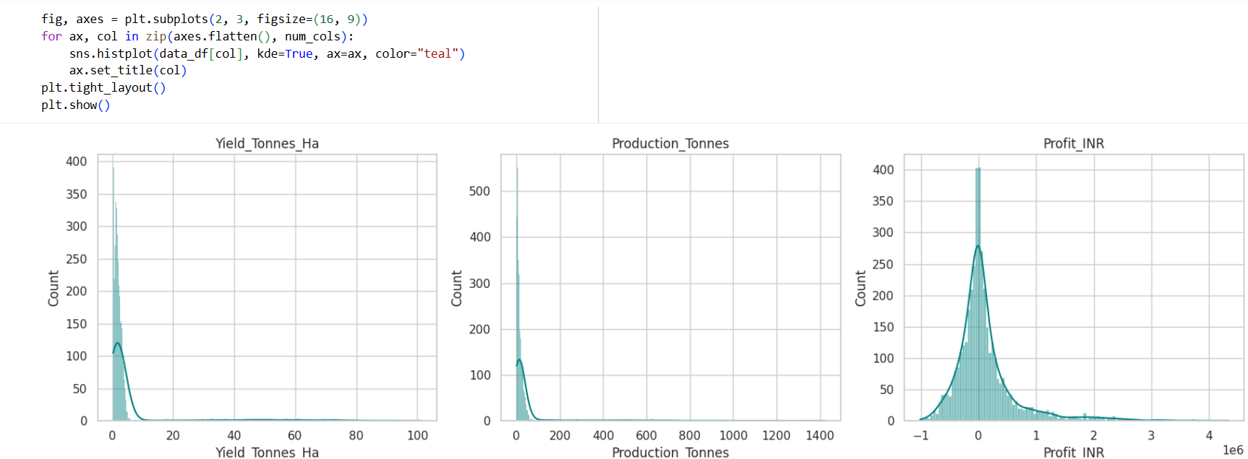
RESULTS
Distribution of Yield, Production & Profit
Notebook result
The distributions are right-skewed, with visible variation and outliers across key agricultural performance measures.

Slide 11
Future Scope
Build an interactive Power BI/Tableau dashboard for seasonal monitoring.
Add multi-year data to validate seasonal trends over time.
Develop predictive models for yield and profitability.
Investigate the practices behind profitable Zaid states.
Add real-time weather, market-price and irrigation data.
Use advanced statistical / machine-learning models for scenario analysis.

Slide 12
GitHub Repository
Seasonal Agriculture Performance Analysis
https://github.com/AdityaBhagour19/seasonal-agriculture-performance-analysis
Repository contains the analysis notebook, dataset and project documentation.

Slide 13

VOIS Course Completion Certificate Course name – Data Visualization
Certificate ID: VFLMS26_160934 | Completed: August 13, 2026

Slide 14
Thank You
Aditya Bhagour
Seasonal Agriculture Performance Analysis
GitHub: github.com/AdityaBhagour19/seasonal-agriculture-performance-analysis

